Slide 1
User Registration
Lesson 3 (final lesson )

Slide 2
Today's session
ORM model Object-Relational Mapping (SQLAlchemey)
ORM stands for Object-Relational Mapping, and it refers to a programming technique used to facilitate interactions between object-oriented programming languages and relational databases.
Instead of write SQL queries in conventional styles, it creates objects in python for storing data.

Slide 3
We need to link database with login/register app we did last week
So, users can register, and we can see the record
We need SQLAlchemy
Install it by using following command
​pip install -U Flask-SQLAlchemy

Slide 4
Install bcrypt ( this encrypt all passwords for security)
pip install bcrypt

Slide 5
When you work with a SoftAware you go through all documentation
SQLAlchmey ( database language)
https://docs.sqlalchemy.org/en/20/
SQLite ( database design)
https://www.sqlite.org/docs.html
Bcrypt ( python function used for hashing password)
https://pypi.org/project/bcrypt/

Slide 6

Now import SQLalchmey

Slide 7

Configuration of data base in app
This will create DB folder in project directory as well:

Slide 8
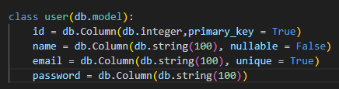
Now we are going to make a class for db:
This actually is a table which has id, name, email and password

Slide 9
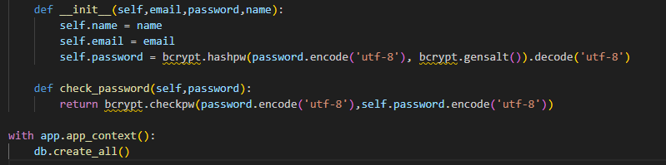
Now we are going to make initializer (__init__)
Email and name are normal however password should be encrypted, for this we need dependency bcrypt

Slide 10
Code explained
This code defines a class with an __init__ method that initialises a user with their name, email, and a hashed password.
__init__: Sets up the user object with the provided details.
check_password method compares a given password with the stored hashed password to verify if they match.
The last part, db.create_all(), is creating all the database tables within an application context.

Slide 11
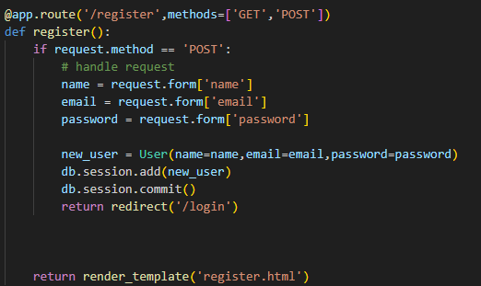
Register code

Slide 12
Register code explanation
This code defines a route /register in a Flask web application that handles both GET and POST requests.
When a user visits the page, it shows the registration form (via GET method).
If the form is submitted (via POST method), it extracts the user's name, email, and password from the form, creates a new User object, adds it to the database, and then commits the changes. Finally, the user is redirected to the login page (/login).

Slide 13
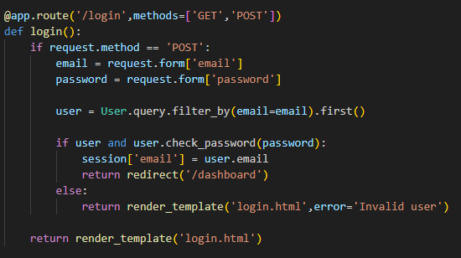
Login Code

Slide 14
Login Code explained
This code defines a /login route in a Flask web application that handles both GET and POST requests.
When the page is visited (GET method), it shows the login form.
If the form is submitted (POST method), it retrieves the user's email and password. It then checks if the user exists in the database using the provided email and if the entered password matches the stored password (via check_password method).
If both are correct, the user's email is stored in the session, and they are redirected to the dashboard (/dashboard). If the login details are incorrect, an error message is displayed on the login page.

Slide 15
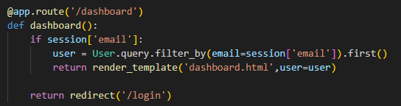
Dashboard code

Slide 16
Dashboard code explained
This code defines a /dashboard route in a Flask web application. When a user visits this route, it first checks if their email is stored in the session (indicating they are logged in).
If the email is present, it retrieves the user from the database using the stored email and renders the dashboard.html page, passing the user data to the template.
If the email is not found in the session (indicating the user is not logged in), they are redirected to the login page (/login).

Slide 17

Log out route

Slide 18
Log out route explained
This code defines a /logout route in the Flask web application. When a user visits this route, it removes their email from the session using session.pop('email', None), effectively logging them out. After logging out, the user is redirected to the login page (/login).

Slide 19
Code is available in Moodle
Downlaod folder
Unzip it
Copy all files and make a brand new folder in your home are and paste all files
Run the code, ( don't disappoint if it doesn't work in first go)

Slide 20
So, what we did !
We made a table by making class user, table has id, email and password
Then we initialized the class by defining __init__.
Lastly, we make check password function by defining checking, which checks if passwords are same as was set by the user.

Slide 21
Flask documentation
https://flask.palletsprojects.com/en/stable/

Slide 22
Presentation of work
Present your work (Christmas assignment)

Slide 23
Homework (review of prior learning)
You need to make a navigation bar, as you made a page with three column Name, Email and Password
Feel free, to get code from Boot strap W3 school.

